Slide 1


WSO2 API Manager
An open source approach to addressing any spectrum of API lifecycle, monetization and policy enforcement.
Product Overview

Slide 2
Agenda
Intro to WSO2
WSO2 API Manager Demo
Developer experience
Consumer Experience
Admin experience
Other features
Licences, support etc…

Slide 3
Intro to WSO2

Slide 4







WSO2 At-A-Glance
500+
Employees
(300 Engineers)
500+
Customers,
Founded 2005, Backed by Cisco and Toba Capital
Open
Source
Mountain View, Colombo, London, Berlin New York, São Paulo, Sydney
$37M in 2018 Subscriptions,
51% YoY growth
Notes:
16M 2016
24.5M 2017
37M 2018

Slide 5
The WSO2 Integration Agile Platform
API Mgmt is central to solving the integration challenges enterprises face today
Solutions: Telco | Open Banking | Healthcare | GDPR |
WSO2 Methodology for Agility
API MANAGEMENT
ENTERPRISE INTEGRATION
IDENTITY & ACCESS MANAGEMENT
WSO2 Architecture for Agility
Cloud-Native Deployment
Kubernetes | Ballerina | Cellery
Notes:
The WSO2 Integration Agile Platform is our approach to People, Process and Organization to bring agility to integration.
4 Technology Pillars: These represent our broad, open source, single code base approach to integration technology. Each functional pillar consists of multiple technologies and components.
Develop * Reuse * Run * Manage is another look at how we bring our products and components together to serve the needs of integration teams at every stage of the integration process
WSO2 Methodology for Agility - Our 5-stage maturity model and approach to delivering agile integration transformation to our customers.
WSO2 Architecture for Agility - Our 5-stage architectural transformation approach to help our customers make the move to a continuous integration organization

Slide 6
All Projects are API-First Digital Transformation But API management does not exist in a vacuum
Start with API management
Complement APIs with integration, security and analytics that connect apps and data.
API MANAGEMENT
API design, creation, reuse, governance, and analytics
ENTERPRISE INTEGRATION
Orchestrates composite services layers
Connector library help API Manager consume SaaS services in integration layer
Converts real-time data streams into integratable APIs
IDENTITY & ACCESS MANAGEMENT
Secures internal/external API access
Bridges multiple IAM systems and API ID systems.
Unifies IAM foundations for common security, SSO, and flows/sessions
20K APIs for 200K orgs
6 trillion transactions / yr
80M identities managed
API analytics
API designer
API gateway
API microgateway
API publisher
API storefront/marketplace
API repository/registry
ESB
Integration designer
Message broker
Workflows
Stream processing
Identity management
Identity federation / SSO
Identity bridging
API and microservices security
Strong and adaptive Auth
Access control
Privacy control

Slide 7

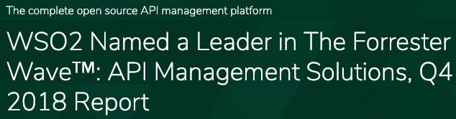

Slide 8

“Strong Performer for API Management Solutions”
- The Forrester Wave™: API Management Solutions, Q4 2016 report, published November 14, 2016.
“Visionary”
- Gartner Magic Quadrant for Full Life Cycle API Management, published 2018

Slide 9
WSO2 API Manager

Slide 10
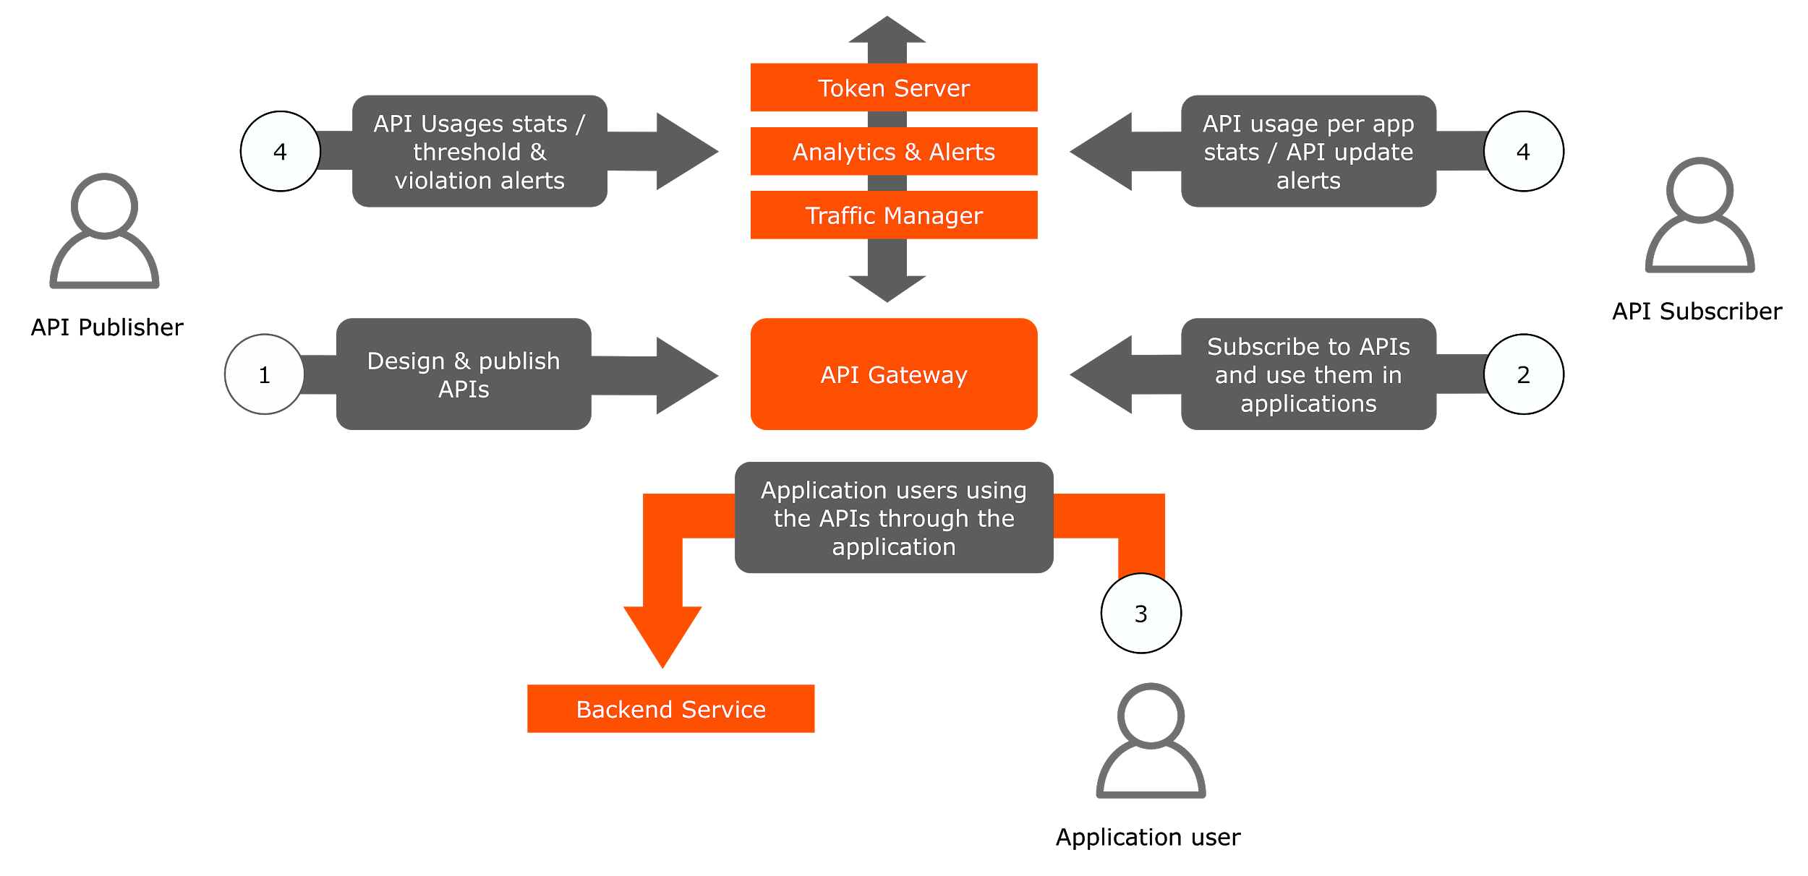
API Lifecycles
Notes:
Which also provides a framework for further customization and extension.

Slide 11
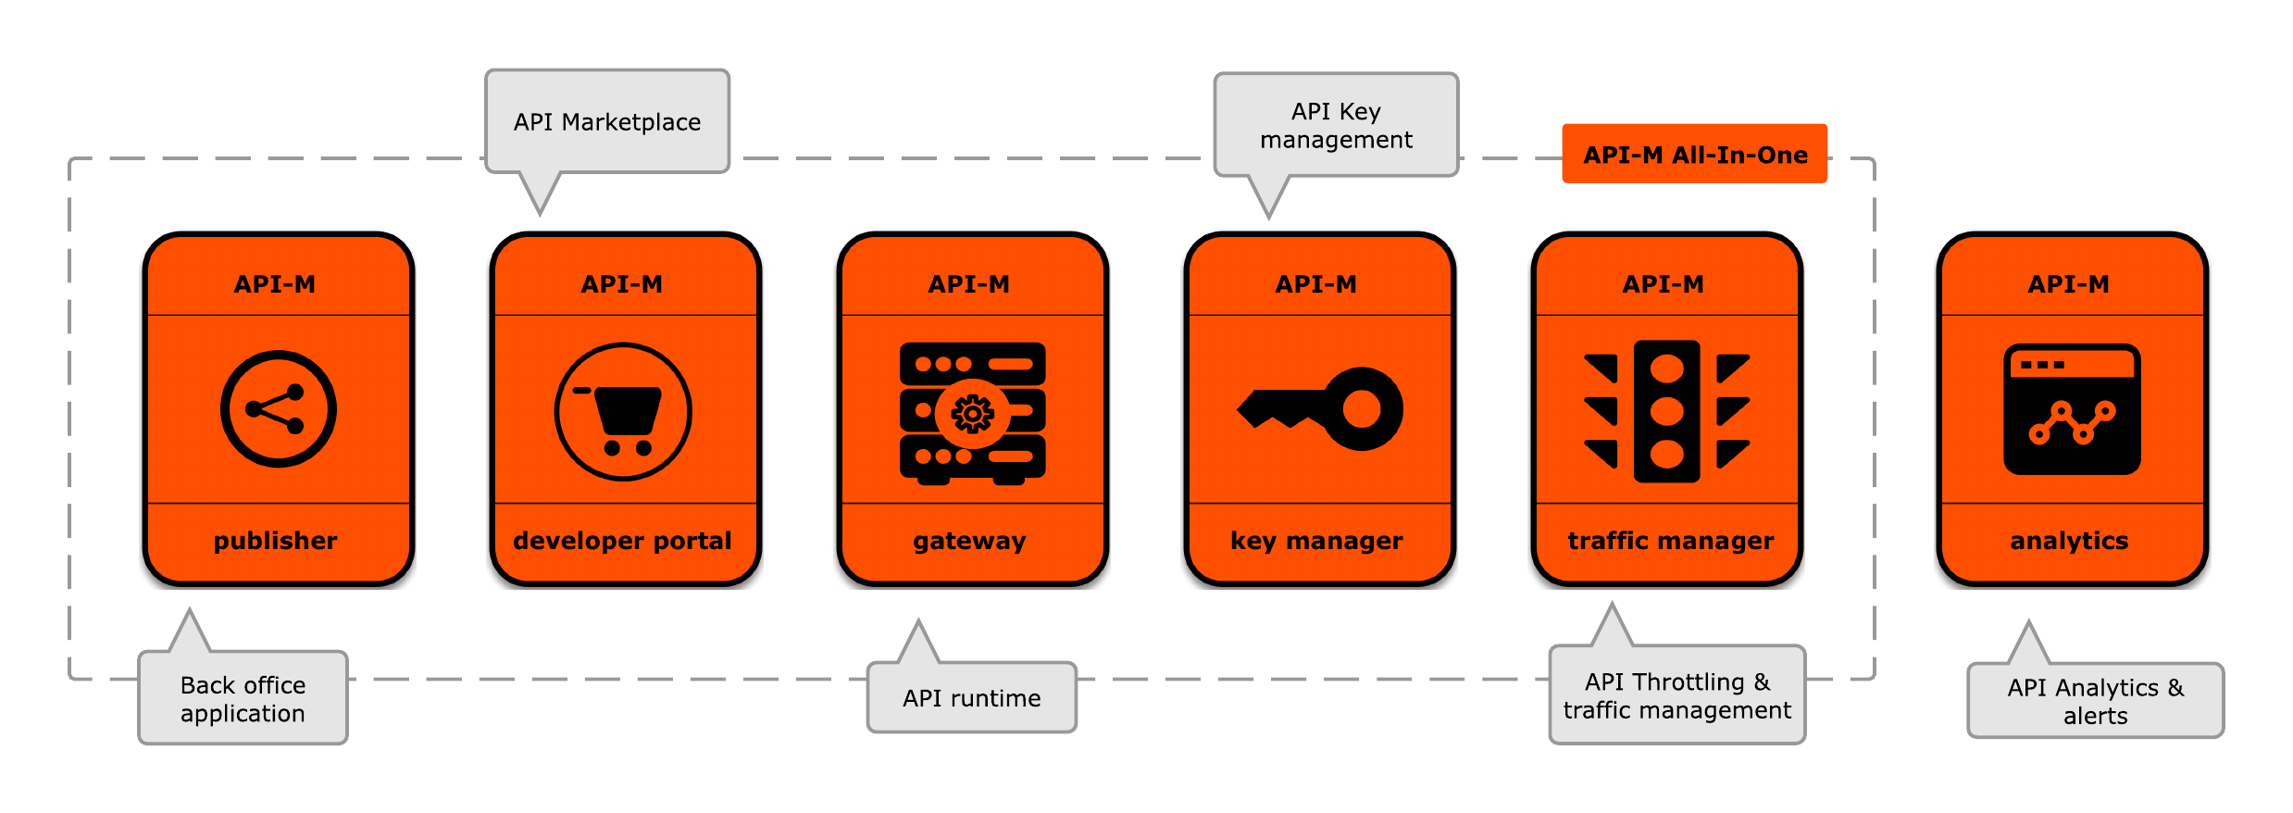
WSO2 API Manager components

Slide 12
Developer experience
APIs from swagger definition, wsdl, graphQL
API definition from command line
Apply policies
Security (OAuth, TLS, … )
Throttling, Business Plans
Caching
Transformation
Data transformation, data mapping, invoke external call
API Lifecycle
Versioning
API Products

Slide 13
Demo
Developer Experience

Slide 14
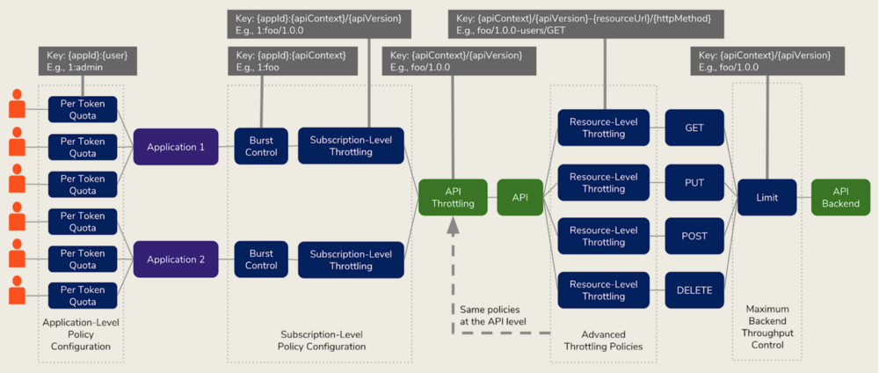
Rate Limiting

Slide 15
Consumer experience
Consumer Portal
Search
Documentation
Sandbox
SDK, Forum...
OAuth process
Token generation
API run (end user experience)
Policy verification

Slide 16
Demo
Consumer Experience

Slide 17
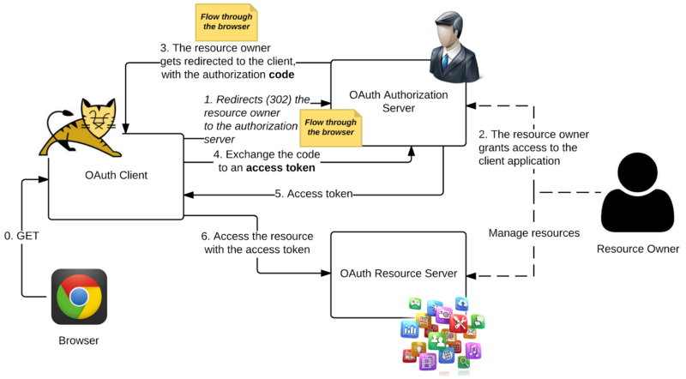
Consumer Experience - OAuth
Authorization Code Grant Type

Slide 18
Deep Dive
Mediation (data transformation, enrichment, filtering, orchestration…)
Scopes (RBAC)
XACML

Slide 19
Administration
Users and Roles Management
Deployment Options
Patterns
Kubernetes support
Monitoring and Logging
JMX
Carbon dump
JVM Metrics
Event Metrics
Analytics and Alert
Admin page

Slide 20
Administration
Other security features
Threat protection, Certificate Management
Bot
Environment management
Export / import functionalities
Admin APIs
CI/CD

Slide 21
Demo
Admin

Slide 22
System Monitoring and Logging
System Logging (log4j), Http access log, Audit Log
JMX-Based monitoring
System Statistics
JVM and Event Metrics
Other options: integrate with EKS, Logtash, Prometheus

Slide 23
Threat Protection
<sequence xmlns="http://ws.apache.org/ns/synapse" name="combinevalidator">
<property name="xmlValidation" value="true"/>
<property name="dtdEnabled" value="false"/>
<property name="externalEntitiesEnabled" value="true"/>
<property name="maxXMLDepth" value="30"/>
<property name="maxElementCount" value="30"/>
<property name="maxAttributeCount" value="30"/>
<property name="maxAttributeLength" value="30"/>
<property name="entityExpansionLimit" value="30"/>
<property name="maxChildrenPerElement" value="30"/>
<property name="schemaValidation" value="true"/>
<switch source="get-property('To')">
<case regex=".*/addResource.*">
<property name="xsdURL" value="http://localhost:8000/shiporder.xsd"/>
</case>
</switch>
<class name="org.wso2.carbon.apimgt.gateway.mediators.XMLSchemaValidator"/>
<property name="threatType" expression="get-property('threatType')" value="SQL-Injection"/>
<property name="regex" expression="get-property('regex')" value=".*'.*|.*ALTER.*|.*ALTER TABLE.*|.*ALTER VIEW.*|
.*CREATE DATABASE.*|.*CREATE PROCEDURE.*|.*CREATE SCHEMA.*|.*create table.*|.*CREATE VIEW.*|.*DELETE.*|.
Combination of
Regular Expression
XML
JSON
BOT

Slide 24
Deployment

Slide 25
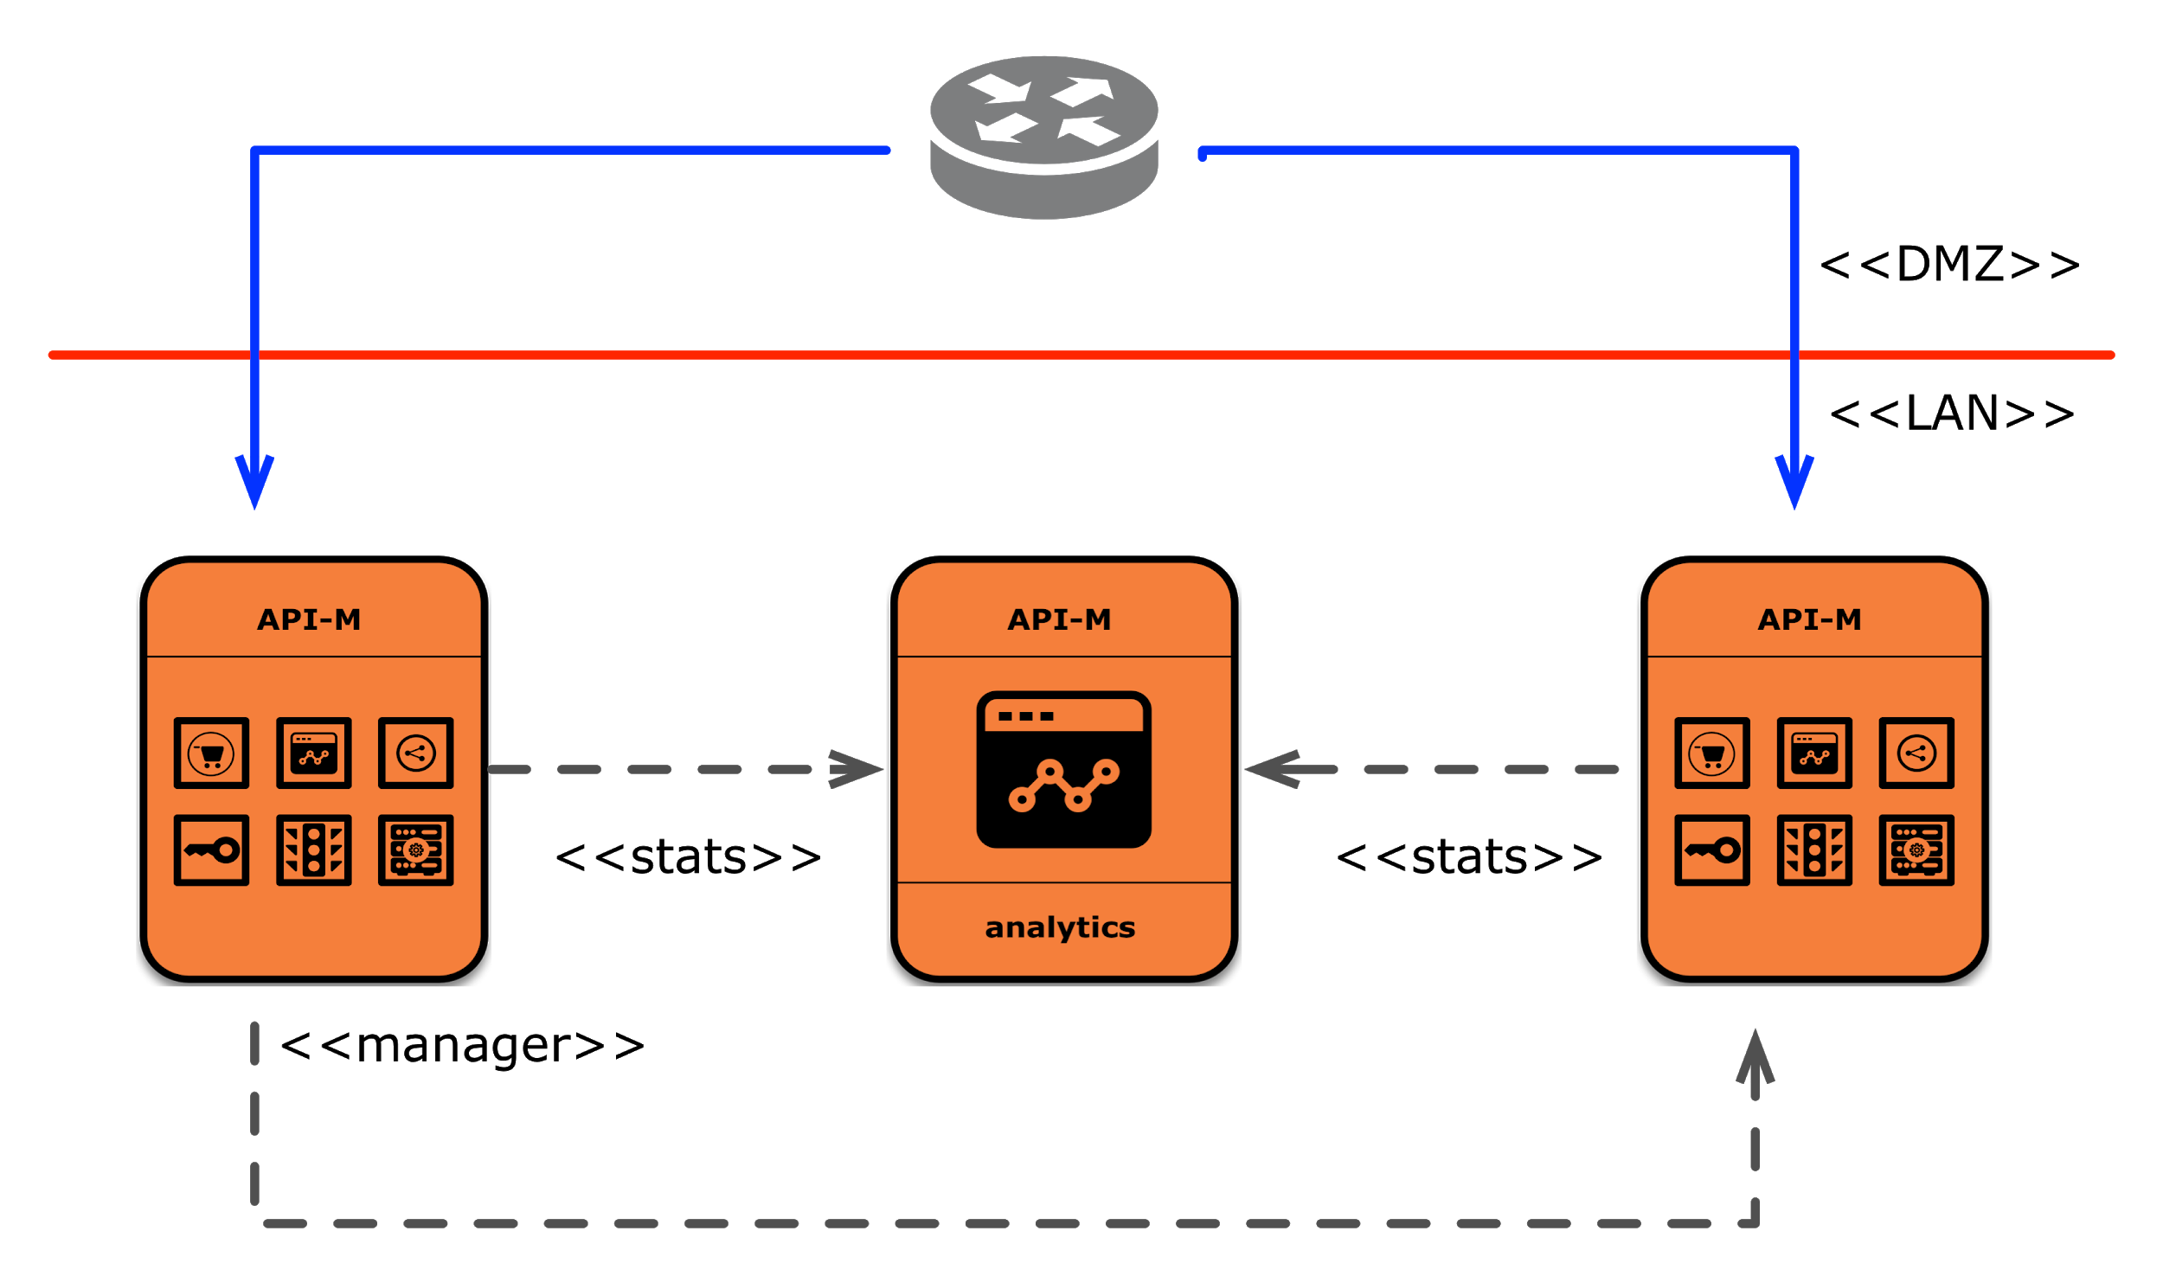
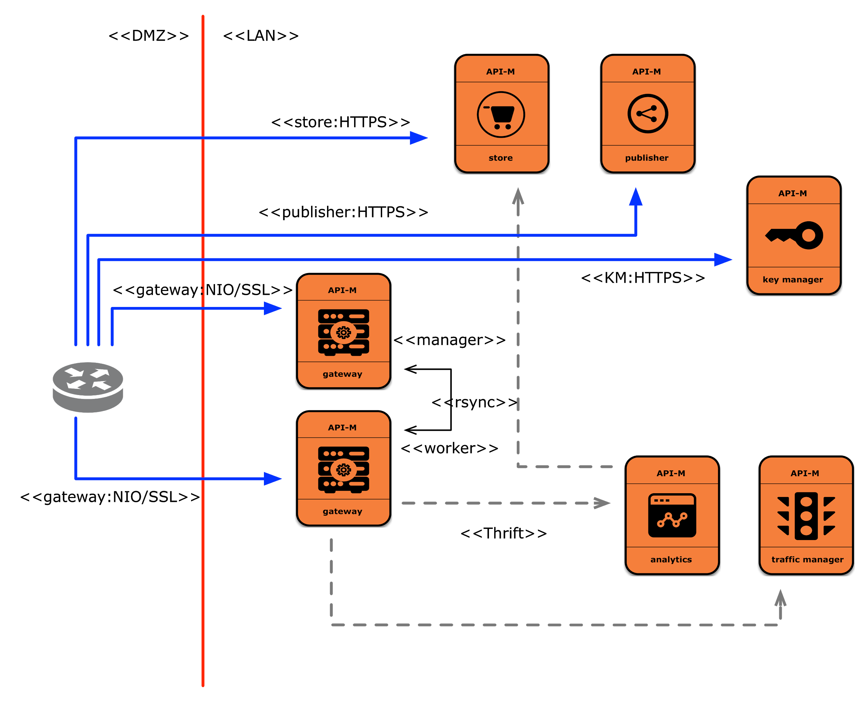
Deployment Patterns
Pattern 2
Pattern 1

Slide 26
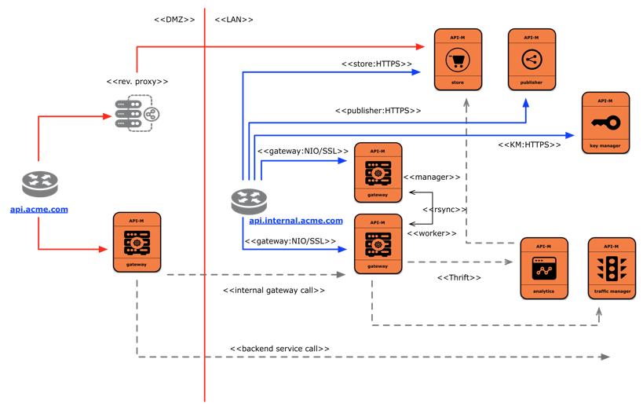
Deployment Patterns
Pattern 3 (only int. GTW)
Pattern 4 (with ext. GTW)

Slide 27
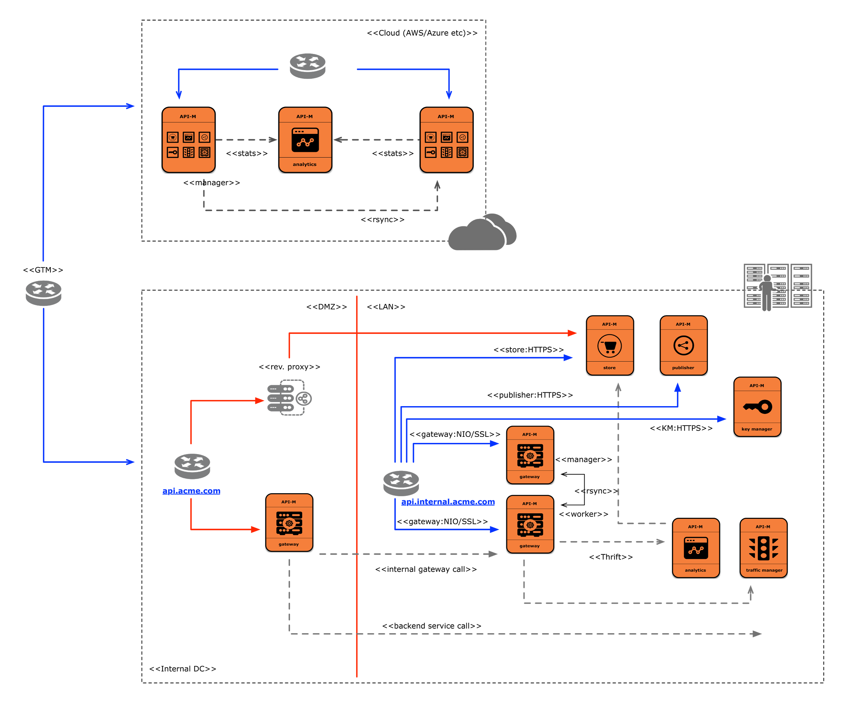
Deployment Patterns - Hybrid Deployments

Slide 28
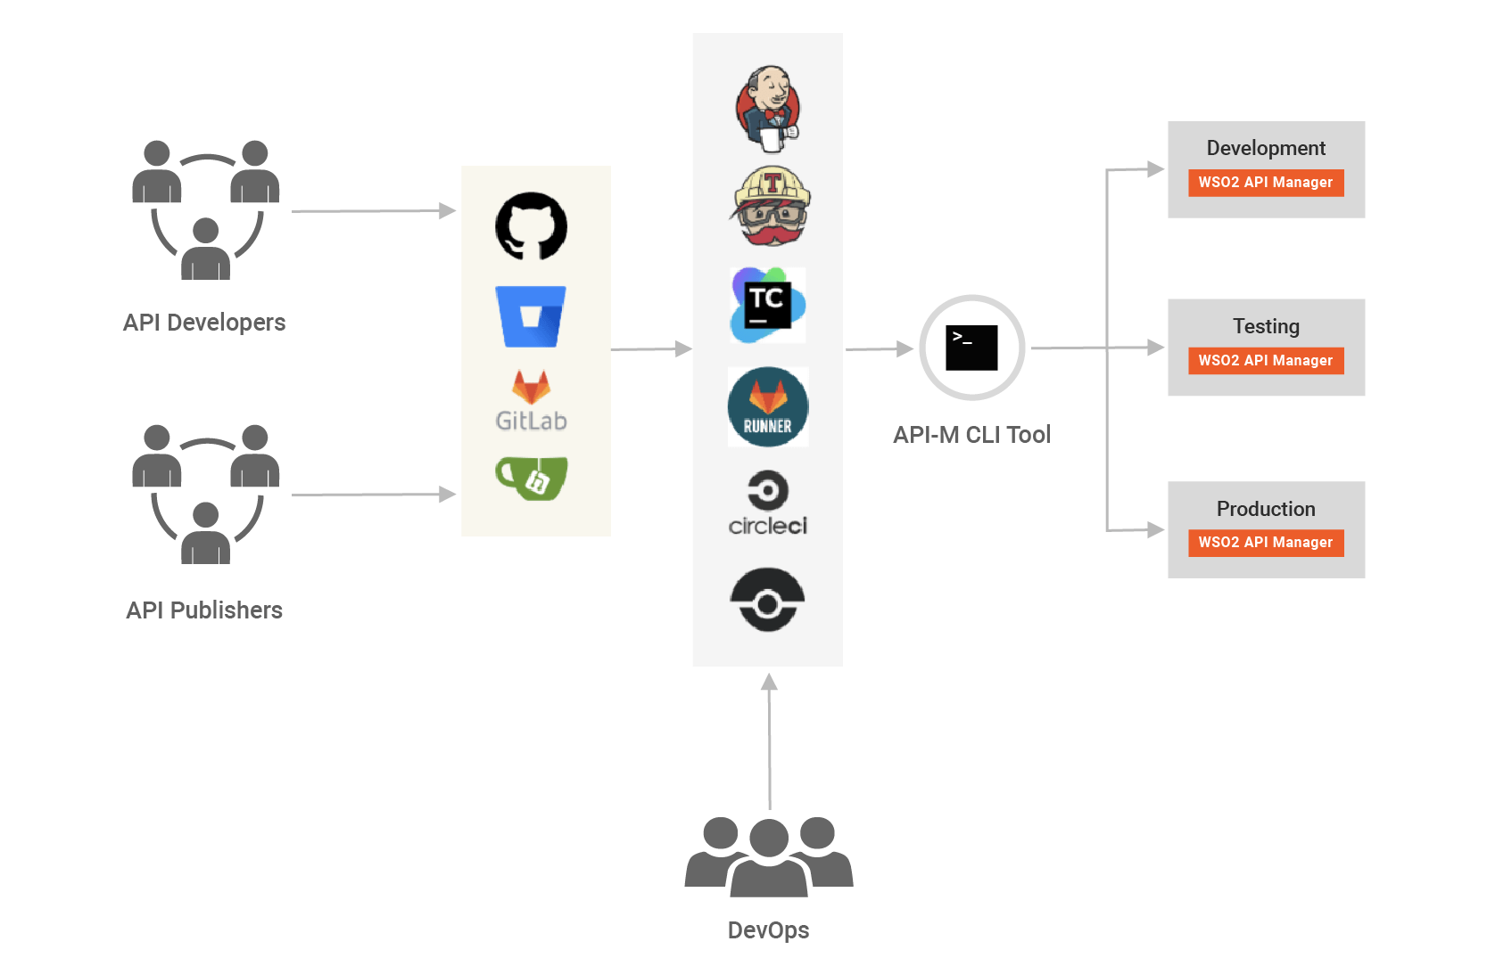
CI/CD
Env. Migration /
Lifecycle Management
Platform Agnostic
Environment related configurations

Slide 29
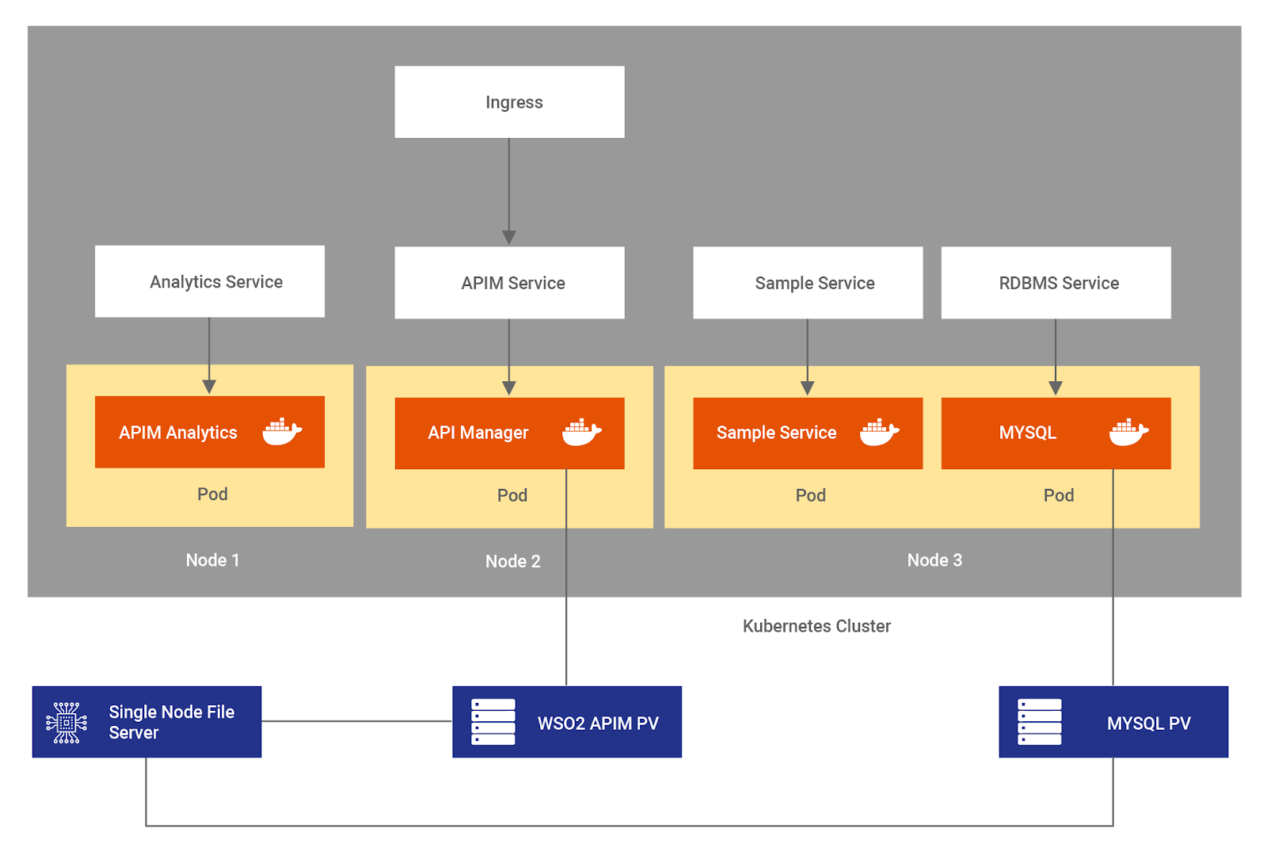
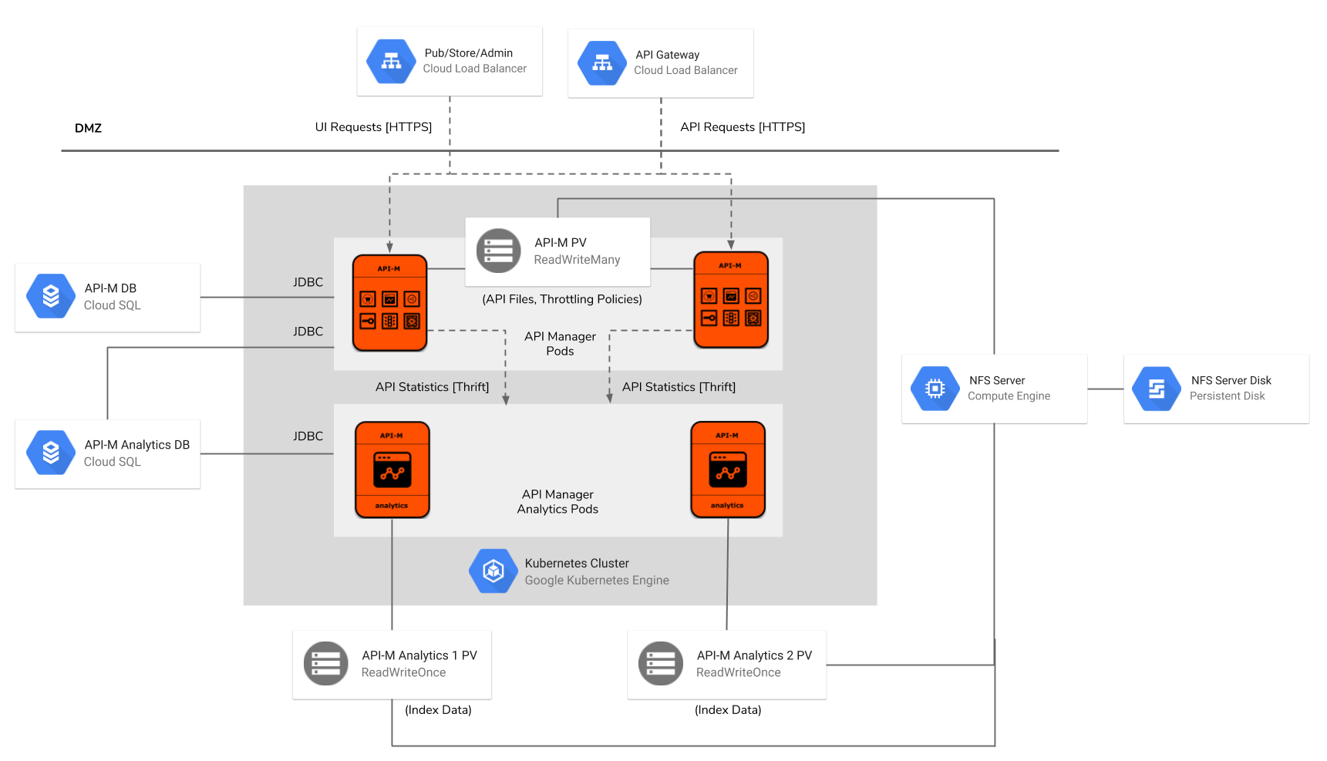
Kubernetes
https://github.com/wso2/kubernetes-apim

Slide 30



Kubernetes & Cloud-Native API Deployment
Providing a Management Plane for the Service Meshes | WSO2 API Manager provides security enforcement, business value reporting and policy enforcement to the Istio Data Plane
Making APIs native in Kubernetes | WSO2 develops CRDs and controllers for Kubernetes so that deployment of APIs can be done using native Kubernetes commands
Monitoring with Prometheus and Grafana | Engineering product components to expose the necessary endpoints to be able to monitor through Prometheus and Grafana
Code-first APIs and Microgateways | Annotating source code (starting with Ballerina) to automatically deploy API proxies on API management and microgateways.
Heterogeneous function calls for events and transformations | Ability to execute functions of different programming languages that are deployed as Kubernetes services

Slide 31
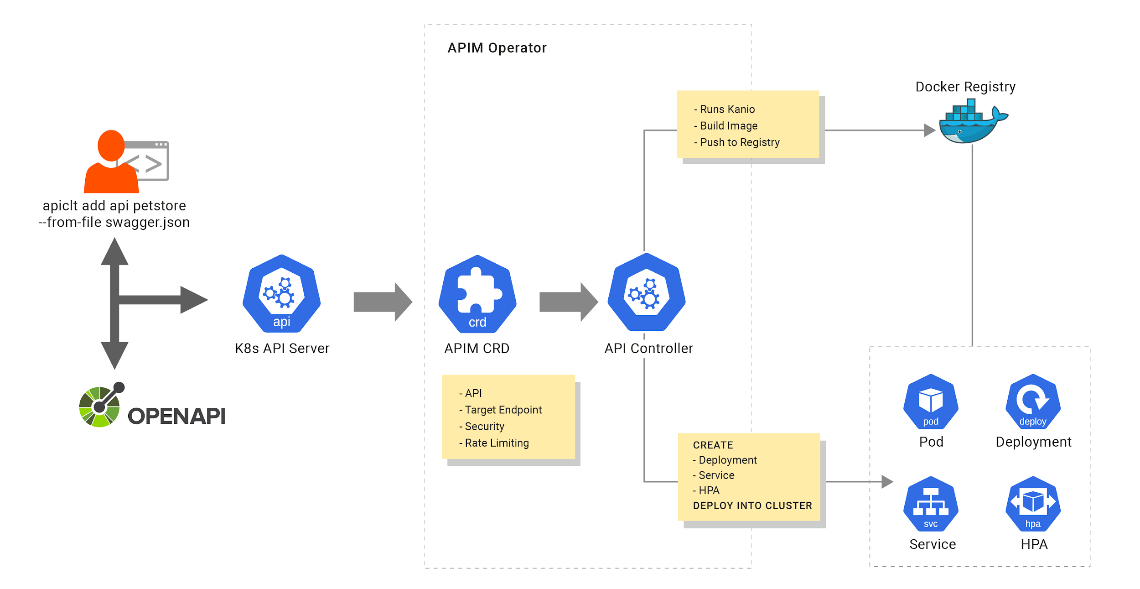
API Operator

Slide 32
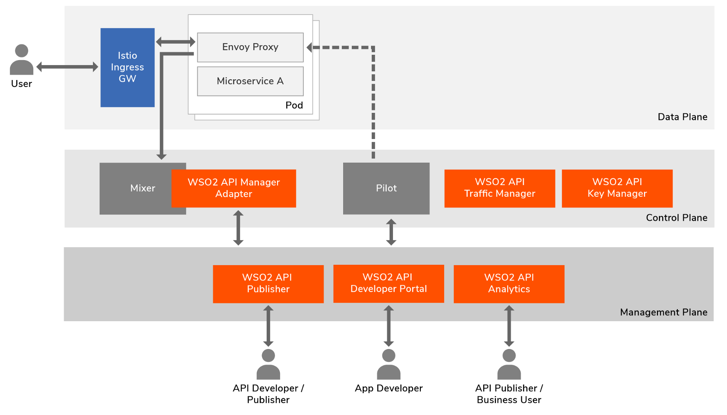
Servicemesh and API Management

Slide 33
Extensions

Slide 34
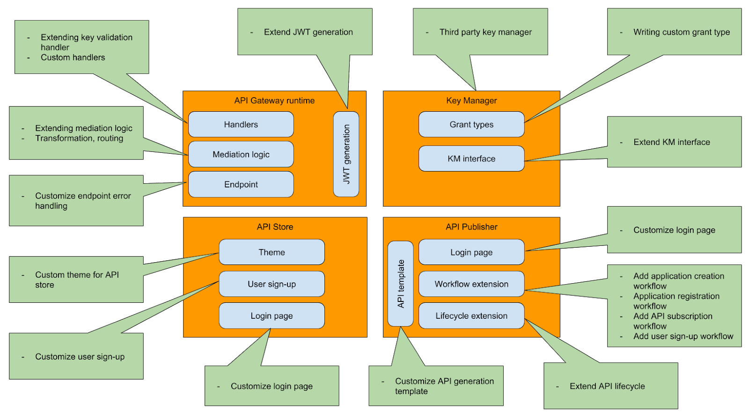

Slide 35
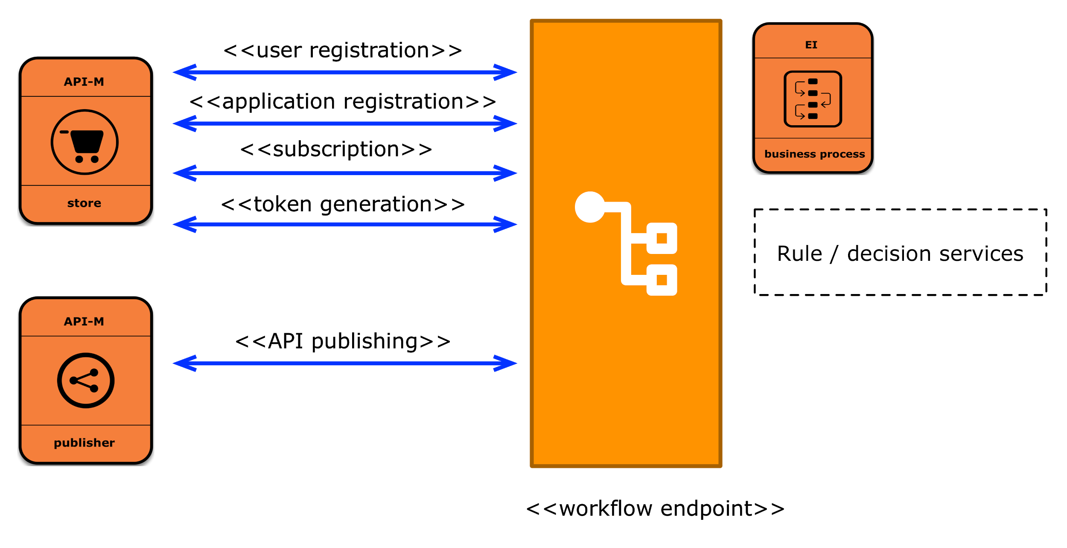
Workflows with and without BPEL
All major interactions are tied to a workflow
API Manager calls an external endpoint
External service can be a BPEL workflow or a service endpoint

Slide 36
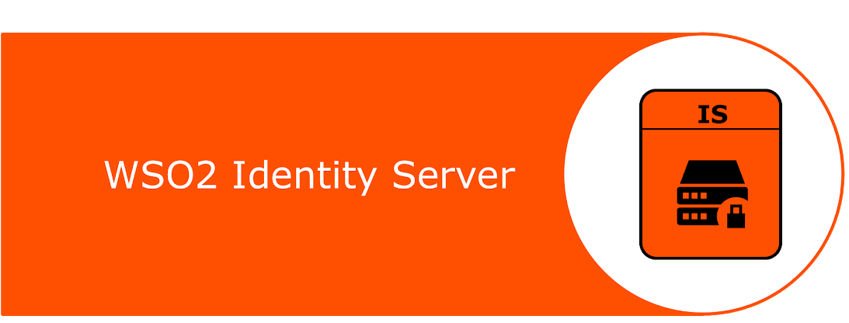


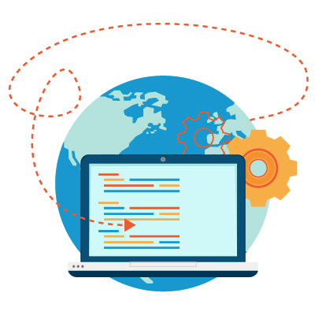
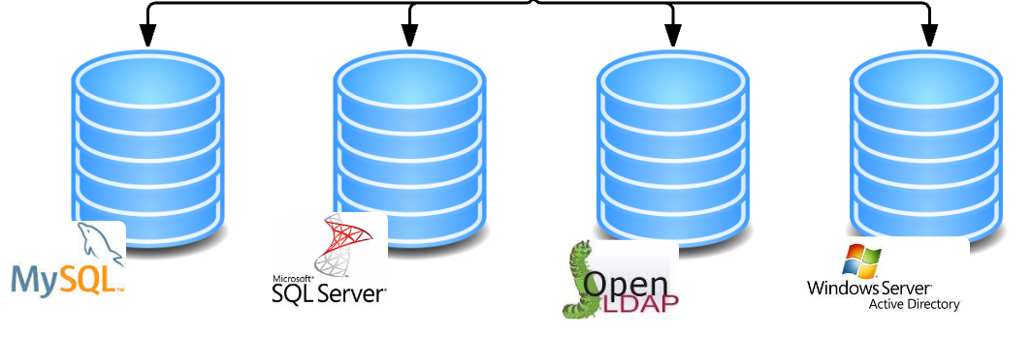
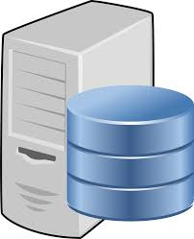
External IdP- Directory Integration
Directory Integration
OAuth2 Authorization Server
Authorization Realm
API Gateway

Slide 37
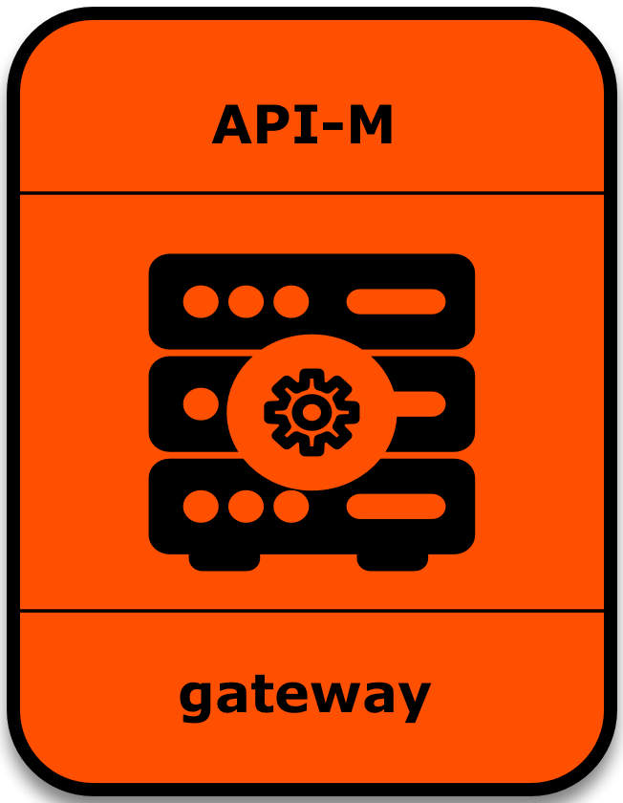
External IdP - Identity Federation
Identity Federation
SAML2 SSO/
OpenID Connect/
WS-Federation/
Etc.
2
OAuth2
OAuth2 Authorization Server
1
Authentication Provider 1
Backend Call
API Call
API Gateway
3
4
Resource Server (1..*)
OAuth2 Client
Authentication Provider 2

Slide 38
External IdP - Assertion Grant Flow
SAML2 SSO/
OpenID Connect/
WS-Federation/
Etc.
Assertion Grant Flows
SAML2/JWT Bearer Grant Flow for OAuth2
1
OAuth2 Authorization Server
Authentication Provider 1
2
API Call
Backend Call
API Gateway
3
4
Resource Server (1..*)
OAuth2 Client
SAML2 SSO/
OpenID Connect/
WS-Federation
Authentication Provider 2

Slide 39
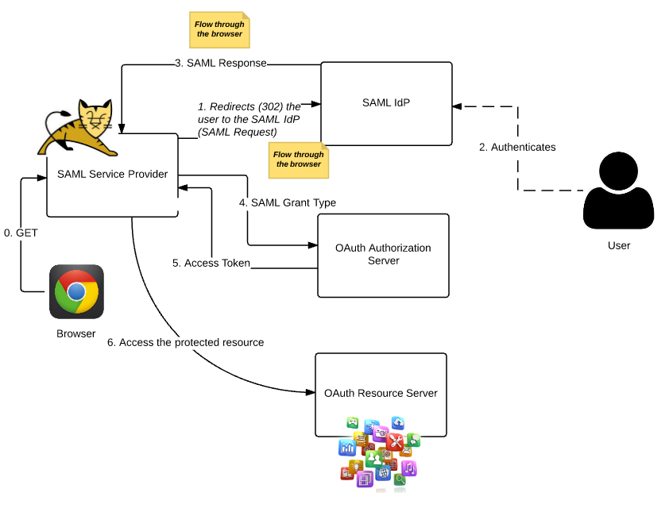
SAML2 Assertion Grant Flow for OAuth2

Slide 40
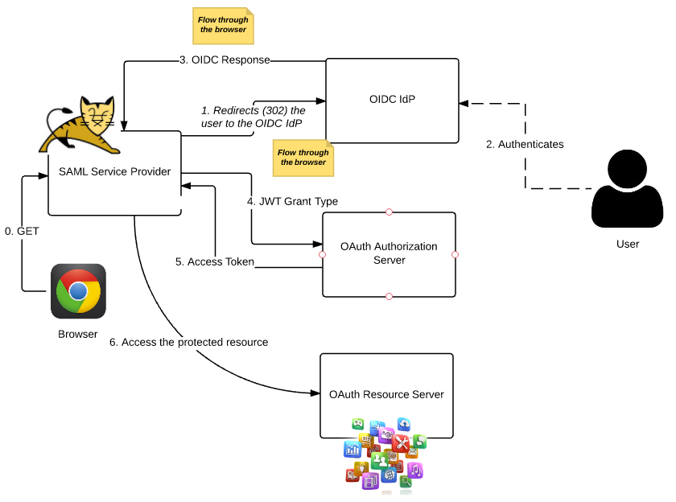
JWT Grant Flow for OAuth2

Slide 41
Broad portfolio of API management functionality
API Manager: Core Competencies
Internal and External API Management
Gateway
Security
Analytics
Cloud Native
Portal/Store
Policy Enablement
Protocol Handling
Transformation
Microgateway
Mobile & Multi-experience
Data & Data as a Service
OAuth2, API Keys
MSSL /TLS
OIDC
Federated ID
SSO
JWT
AI driven API Security
Business value reporting
Streaming & event-driven analytics
Real-time alerting
Traffic management
Monetization
Istio integration
Installations - Kubernetes, Docker, PCF.
Monitoring with Prometheus / Grafana
Improved CI/CD
API Marketplaces
Monetization hooks / partners
Flexible theme-based architecture
Registry and versioning model
Multiple plug-points and extensibility | Open source projects | Flexible deployment options

Slide 42
Subscription
Prizing and Support

Slide 43
The WSO2 Subscription & Support
Get the most from your WSO2 product with enterprise-grade services:
WSO2 Subscription Highlights
Product maintenance | WSO2 Update: Continuous access to product update binaries, bug fixes, security updates, and performance enhancements, for up to 10 years post version release
Enhanced security | Private security bulletins and early access to security updates (Aggressively uncovered by constant monitoring of hundreds of projects, collecting third-party security reports, and automated code-scanning tools)
Incident response | WSO2 Support offers 24x7 expert support with aggressive response and resolution times, with option for a dedicated WSO2 Technical Account Manager
Developer productivity | Query support to keep development moving forward
Operational simplicity | Outsource operations to WSO2 with public or private WSO2 Managed Cloud hosting
Skills | WSO2 Consulting services to nurture skills or fill skills gaps
WSO2 Subscription
Open
source technology
Options: - WSO2 managed cloud - Consulting services
- Managed services

Slide 44
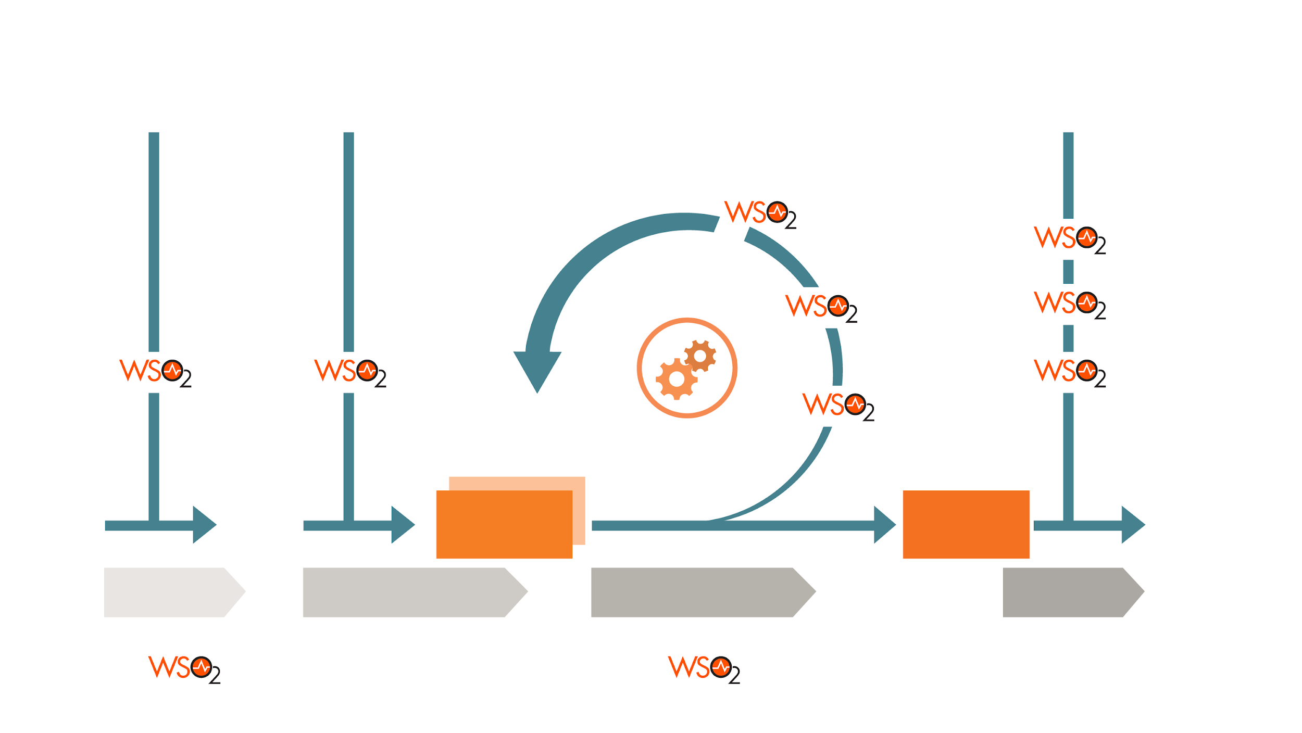
WSO2 Customer Engagement Model
Go Live Engagement
Joint Architecture
Discussion
Consultancy
Workshops
PoC Support
Quick Start Program
Training
Architecture
Review
Design, Build, Deploy, Test, Run
Architecture Iterations
Product
Increment
PROJECT KICKOFF
AND DESIGN
ITERATIVE ARCHITECTURE SPRINTS
GO LIVE AND ON-BOARDING
EVALUATION
Trial Subscription
Subscription

Slide 45




WSO2 Training and Certification
WSO2 Provides
Training material free online; learn at your own pace
Standard training (onsite and online)
Customized training (on-site) in-depth, personalized training for your specific need
Certification a verifiable way to present skills to team, employers, customers, partners.

Slide 46


